Slide 1
Wasserstoff Elektrolyseure im industriellen Maßstab 2. Nationales Wirtschaftsforum Wasserstoff Hamburg, 24.05.2023 Dr. Nima Pegemanyfar, Head of Sustainable Energy Systems / Hydrogen Sales Region Europe

Slide 2
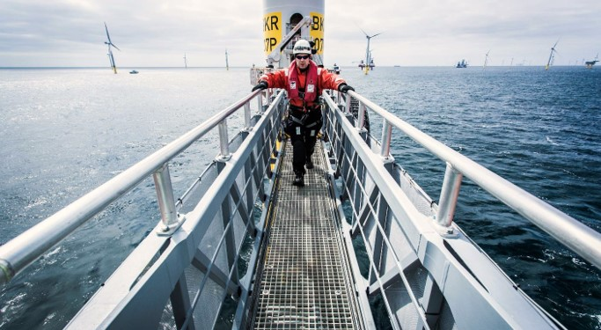
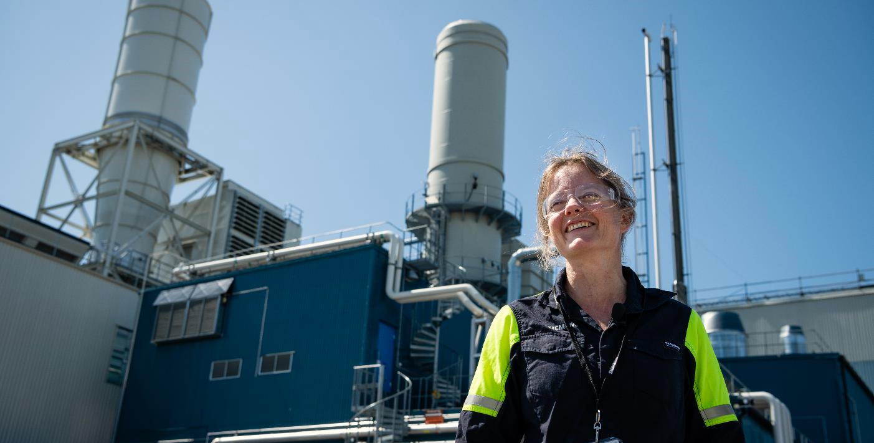
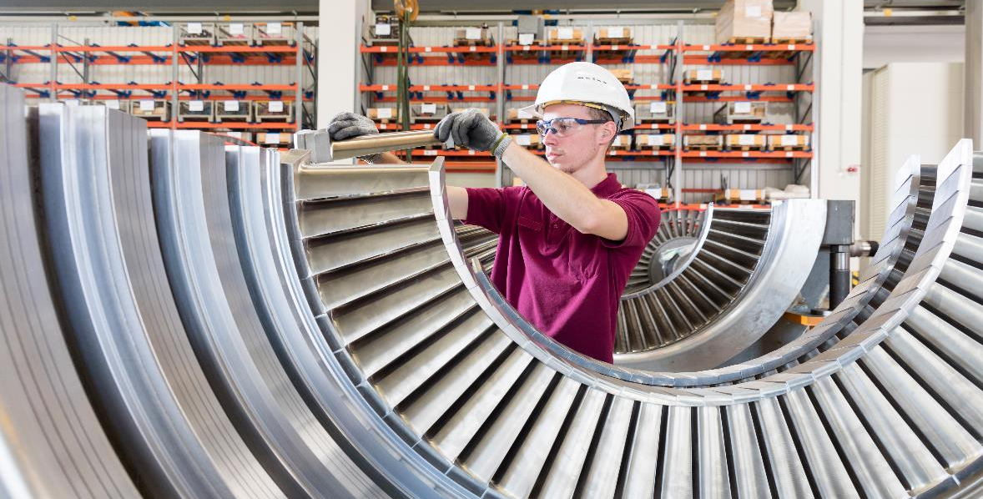
Siemens Energy is a global leader in the energy business
~ 1/6 of global electricity generation is based on our technology.
92,000 employees work as a team to energize society.¹
We are present in > 90 countries.
We invest around €1bn annually in research and development.
1 Number of employees as of September 30, 2022

Slide 3
Siemens Energy can offer products, solutions and services across the whole hydrogen / P2X value chain
Siemens Energy covers most value chain parts to deliver Hydrogen/Power-to-X projects on a turnkey basis
Planning & Consulting
Financing
Components and Equipment
Renewable Power
Grid Connection
Electrolysis
H₂ Compression
& Auxiliaries
Synthesis Processes
Use Cases and Re-electrification
Compression, Heat & Storage
H₂ Compressors (reciproc./radial)
H2 liquefaction (components)
Heat Pumps
Battery Storage
Synthesis
Partnering
e-ammonia
e-methanol
other e-fuels (e-Gasoline, Sustainable Aviation Fuel, etc.)
External supply for N₂, CO₂
H₂ Re-electrification
Heavy-duty, industrial and aeroderivative H₂ gas turbines
H₂ Combined Cycle Power Plants
H₂ Combined Heat & Power (CHP)
Fuel cells (ext.)
Turnkey / Solution Offering
Solution provider for complex and hybrid projects (i.e. H₂ production, PtX and re-electrification)
Solution optimization with Integration of own and external partners portfolio
Digital Solutions
Operation & Maintenance contracts
Green Energy Certification
Wind Park
Onshore wind
Offshore wind
(Siemens Gamesa)
Power Grid
Transmission
Distribution
Substations
Transformers
Grid management
Battery Storage
Island grids
Electrolysis
Electrolysis Plants
Silyzer 300 (PEM)
Electrolysis systems (incl. BoP)
P2X and hybrid solutions
Other RES
Solar PV
Hydro Power
Auxiliary Systems
Hydrogen storage
Water treatment
Mech. equipment
Electr. equipment
Own/majority owned portfolio
JV/partnering
Portfolio from external partners

Slide 4
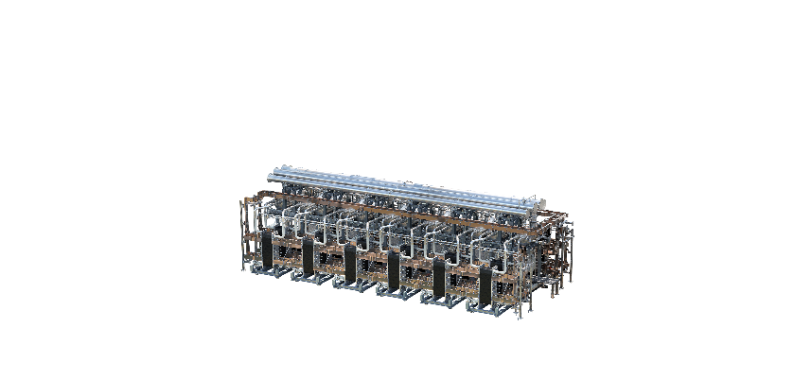
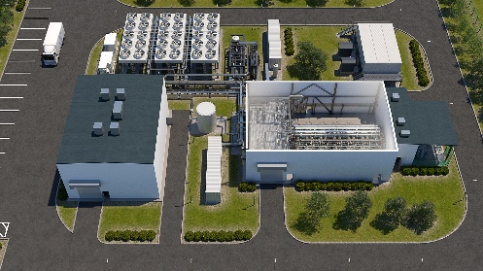
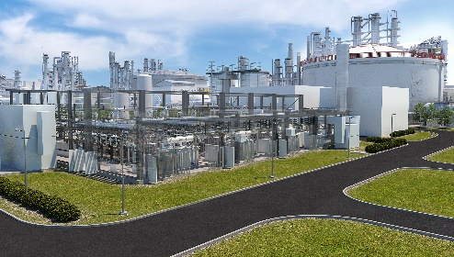
Technology expertise in Electrolysis Our electrolyzer portfolio scales up by factor 10 every 4 – 5 years
0.1 MW
1 MW
10 MW
100+ MW
1,000+ MW
2011
2015
2018
2023
Next step
Silyzer 100 Lab-scale demo
Silyzer 200
Silyzer 300
Silyzer 300 plant
Co-Development with partners in verticals
Sustainable Energy Systems
4
May 2023
Siemens Energy is a trademark licensed by Siemens AG.
Unrestricted use © Siemens Energy, 2023

Slide 5
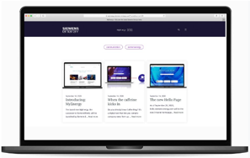
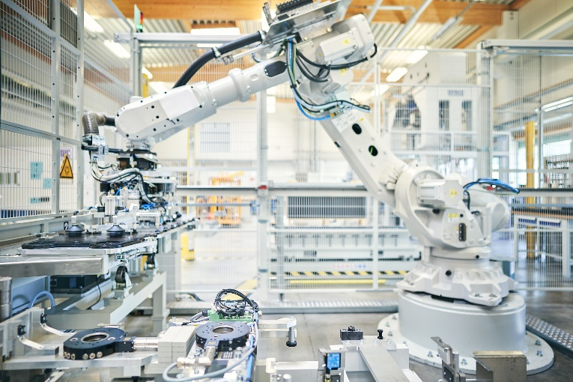
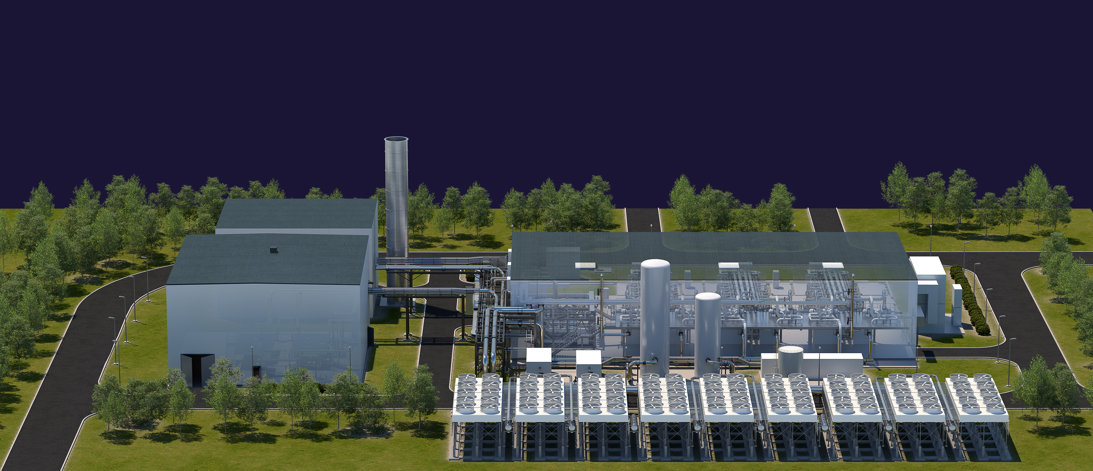
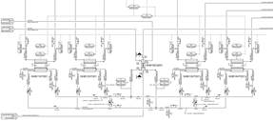
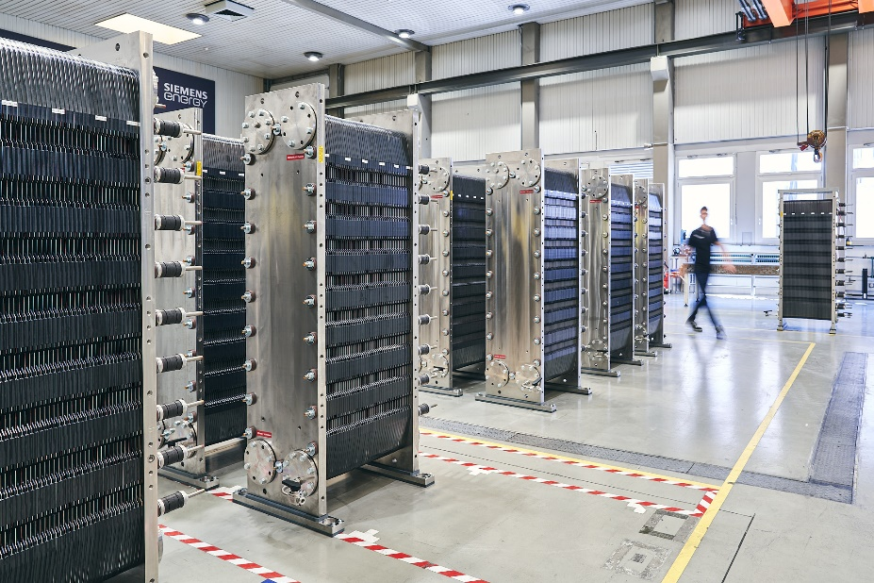
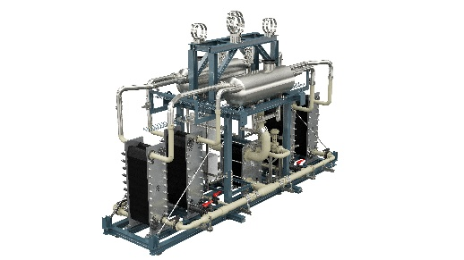
Prepared for delivery at Gigawatt scale Standardization, Modularization and Manufacturing
Digital engineering
50 MW plant design based on Silyzer 300
Pre-fabricated group of 4 stacks
Silyzer 300 array system design
Standardized plant design based on modular building-blocks
Pre-fabricated groups with pre-defined interfaces
Integrated digital engineering tools
Ramp-up of manufacturing towards a lean Gigafactory
Flexible expansion to Multi-GW
Automated, highest-quality Silyzer production

Slide 6
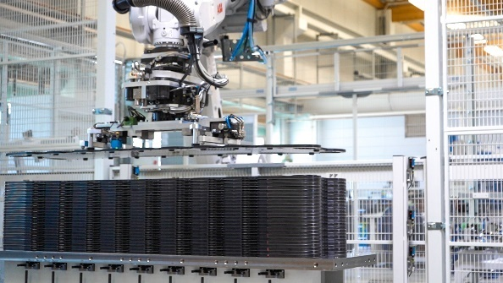
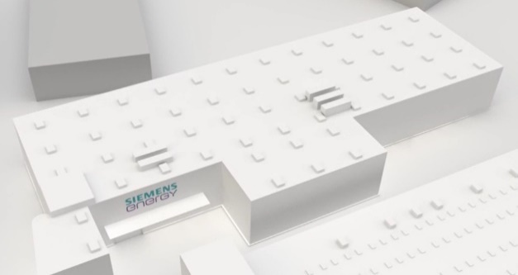
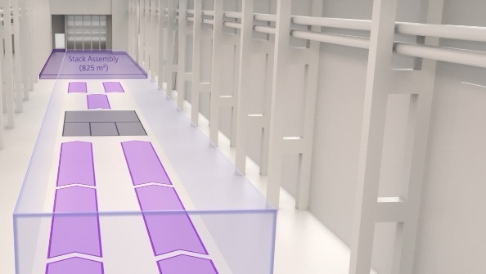
Ready to deliver large-scale electrolysis systems + capacity increase in Germany is locked and loaded
2021
Erlangen
2023
Berlin + Erlangen
2025
Berlin
1GW/year
250 MW - 750 MW
1 GW
3 GW
Implementation of modern robots
Fully automated production line
Industry 4.0 Digitalization implemented
Inhouse design allows for internal and external local packaging
Packaging will be established depending on the development of the markets
Capacity growth plan locked-in and layouts finalized
Additional 1 GW per year depending on demand
Notes:
¹ planned annual production capacity by end of the year, subject to market development

Slide 7
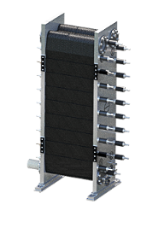
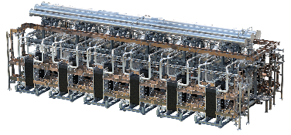
Industrial scale production of Electrolyzer with up to 1GW in 2023 and 3GW in 2025
PEM multi-Gigafactory
Product development
Joint Venture Manufacturing in Berlin
Industrial scaling up to 1GW in 2023 and 3GW in 2025 (1 GW expansion each 12 month)
Highly automated PEM manufacturing according to latest production standards
R&D for electrolysis technology
Operations, engineering, sales and service
Partially automated PEM production (ending 2023)
Berlin
Mülheim
Erlangen
Stacks
Electrolyzer Packaging
Siemens Energy internal and external partners for final assembly to prepare for optionality acc. Market trends
Packager will be established locally in main markets to facilitate local value add
Array

Slide 8
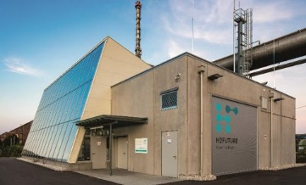
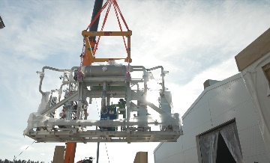
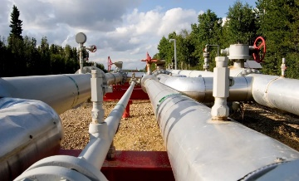
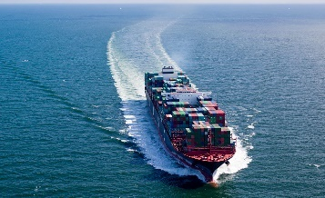
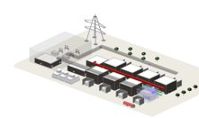
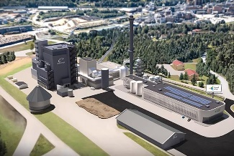
Projects completed or in implementation based on Silyzer 300 Scale-up is already happening
6 MW
8.5 MW
17.5 MW
50 MW
50 MW
70 MW
200 MW
H2Future Linz
Green hydrogen for the steel making process
Our partners: VERBUND, voestalpine, Austrian Power Grid (APG), TNO, K1-MET​
Wunsiedel
Green hydrogen for industry, grid services and mobility
Our partners: Siemens AG, WUNH2, SWW Wunsiedel GmbH
Oberhausen
Green hydrogen for Air Liquide pipeline infrastructure
Our partner:
Air Liquide
e-Methanol Kassø
Green hydrogen for CO₂-neutral shipping at large-scale
Our partner: European Energy
Chemical Company
Hydrogen for chemical site
FlagshipONE
Green hydrogen for CO₂-neutral shipping at large-scale
Our partner: Ørsted
NormandHy
Renewable electricity
Engineering and Long Lead Started
Our Partner:
Air Liquide
Siemens Energy is a trademark licensed by Siemens AG.

Slide 9
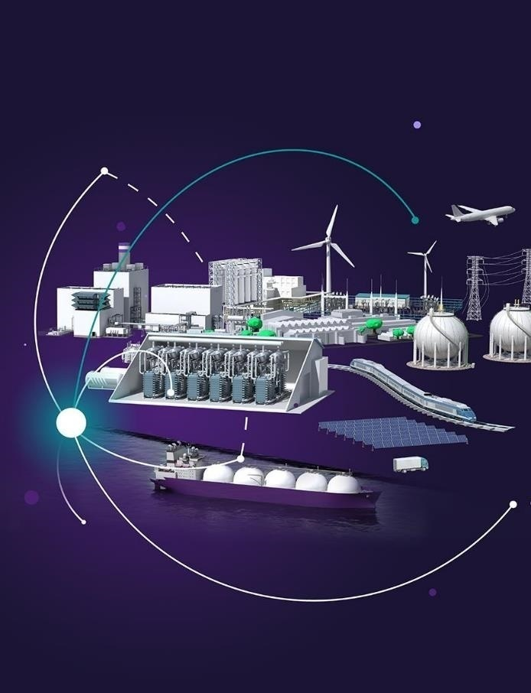
WHY
Green hydrogen is the second stage of the energy transition
Indispensable for decarbonization
In-house PEM electrolysis technology
Large Power-to-X-solutions enabled by the full Siemens Energy competence
Digital twin and service concepts
WHAT
Secure technology and cost leadership
Implement Giga factory
Strong international partner ecosystem
HOW
We know how to industrialize technologies!
May 2023

